Slide 2
TIme-LIne and IntroductIon

Slide 3
TIme LIne and Chronology
Reform in the Late Ottoman Empire, as a legacy to the new Republic
The New Turkish Republic and its progress and crisis
Multiparty Politics and political life in Turkey since 1946

Slide 4
Reform in the Late Ottoman Empire as a Legacy to the New Republic
1789-1876
Early Reformers and Tanzimat Era
1789-1838
Selim III
Mahmut II
1839-1876
Tanzimat (Restructuring) Era
1876-1909
Constitutional Periods and Abdulhamid II
1876-1878
1st Constitutional Period
1908-1918 Second Constitutional Period and the Commitee of Union and Progress in Power
1876-1909 Abdulhamid II
1908-1909 Beginning of the Second Constitutional Period
1908-1913 Consolidation power of CUP
1913-1918 CUP in power
1914-1918 1st World War

Slide 5
The New Turkish Republic Its progress and Crisis
1918-1923
Independence War
1923-1927
Consolidation of Power Period of Republican People's Party
1927-1946
Republican Peoples Party
The Single Party Era
1939-1945
Second World War and Its Effects in Turkey
1922-1923
Lausanne Conference
1922
Abolishment of the Sultanate and the end of the Ottoman Empire

Slide 6
Multiparty Politics and political life in Turkey since 1946
1946-1960
Democrat Party and The First Real Multi-Party Experience of Turkey
1945-1950
Liberalization in Turkey
The Establishment of Democrat Party
1950-1960
The Democrat Party in Power
1961-1980
Military Guardians, Second Republic and Polarization in Politics
1961*1971
New Political Parties and Ideology Politics in Turkey
1960
Military Coup
1971 Military Memorandum
1972-1980
Polarization of Turkish Politics, Economic Crisis and Violence in the streets
1980 Military Coup
1980-2000's
The Military, Parties and Globalization
1983-1993
Rule of Motherland Party and Turgut Özal
1994-1997
Rise of Welfare Party and Discussion of Political Islam
28th of February 1997
Post-Modern Military Coup
2002-continuing
Justice and Development Party in Power

Slide 7
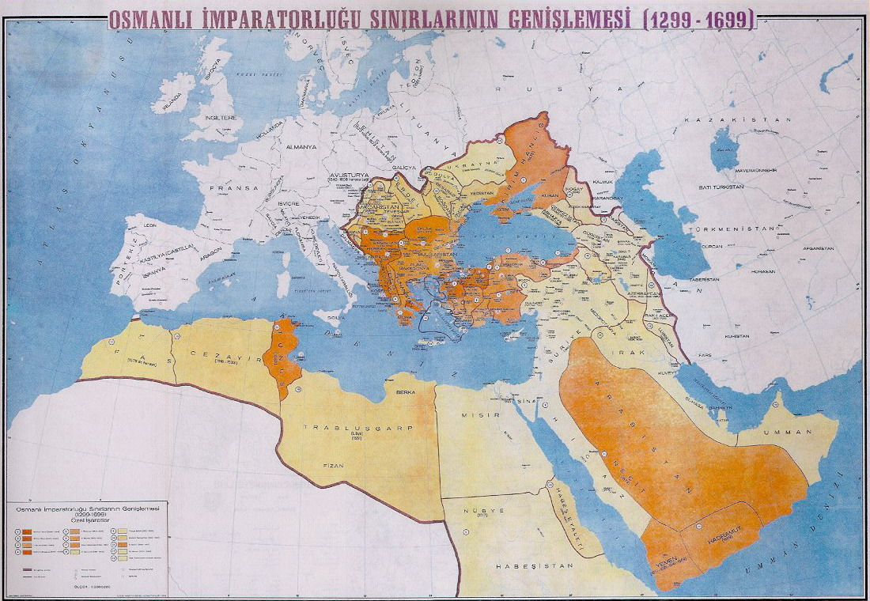
IntroductIon to Ottoman EmpIre
«The past is a foreign country; they do things differently there.» L.P. Hartley

Slide 8
Ottoman Classıcal System
Patrimonial Empire
Diversity and fragmentation
Small state
Sharia law
Empire of conquest

Slide 9
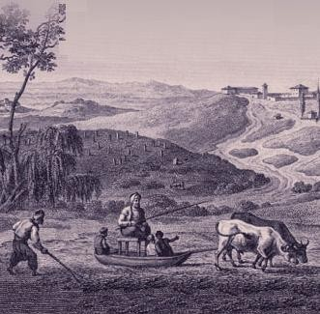
OTTOMAN CLASSICAL SYSTEM
Tımar System
Timar system was a solution to the problem of cultivating the land, maintaining the public security and raising soldiers for the army.

Slide 10
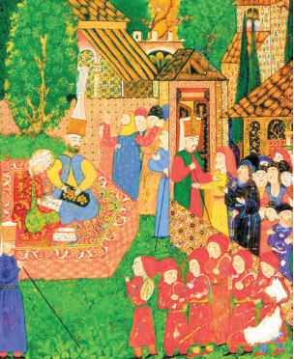
OTTOMAN CLASSICAL SYSTEM
Devshirme System
Devshirme system was a method for recruiting soldiers and administrative staff for the Empire.

Slide 11
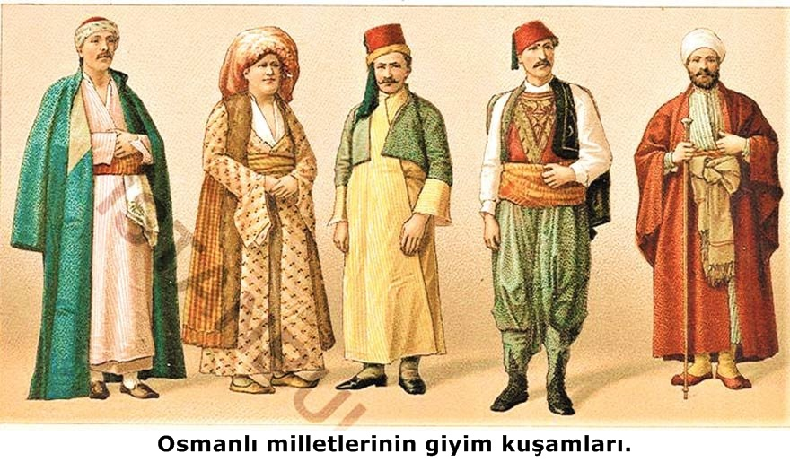
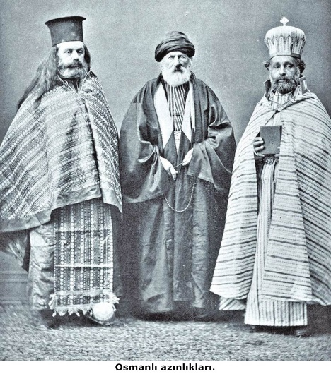
OTTOMAN CLASSICAL SYSTEM
Millet System
The division of subjects into religiously oriented communities.

Slide 12
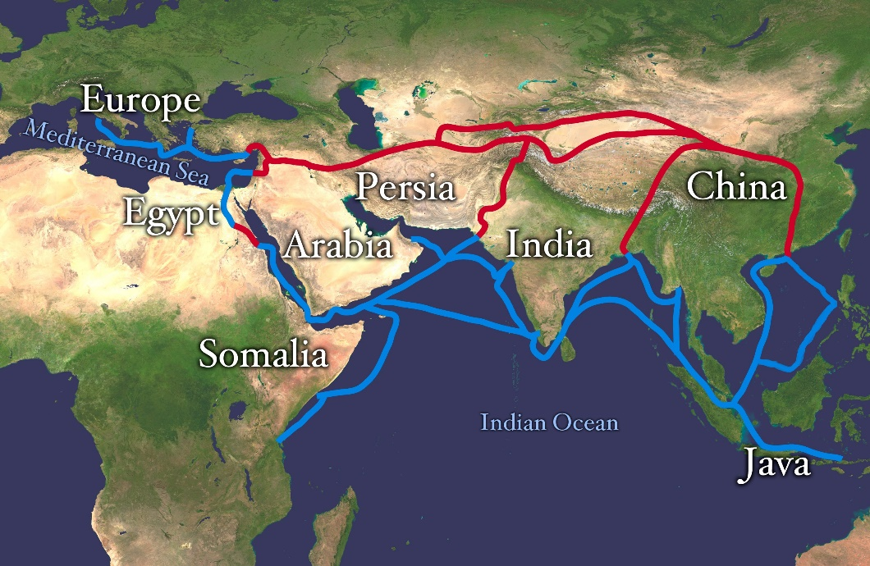
What Changed tıll Late 18th Century?
Changing Trade Routes
Inflation
End of Conquests
Geographical and Logistical Limitations
Population Growth
Changes in Devshirme System and Janissaries
Changes in taxation and Tımar control.

